Slide 1
Grouping Principles
In Germany in the early twentieth century, researchers known collectively as the Gestalt psychologists (Gestalt is the German for “form” or “shape”) began to uncover some of the grouping principles that guide the visual system and produce our perception of what goes with what.
Chapter 2

Slide 2
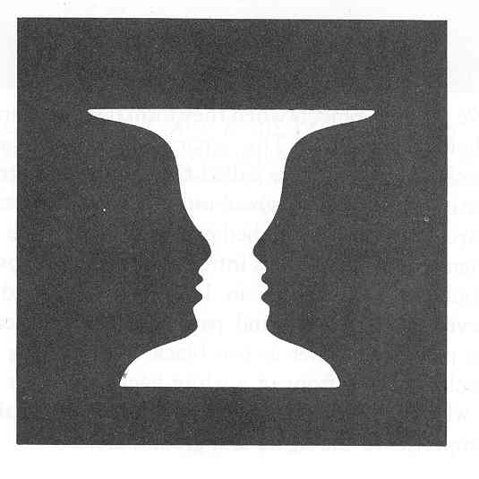
Slide 66-Goldstein Figure 6.24
Figure and Ground

Slide 3
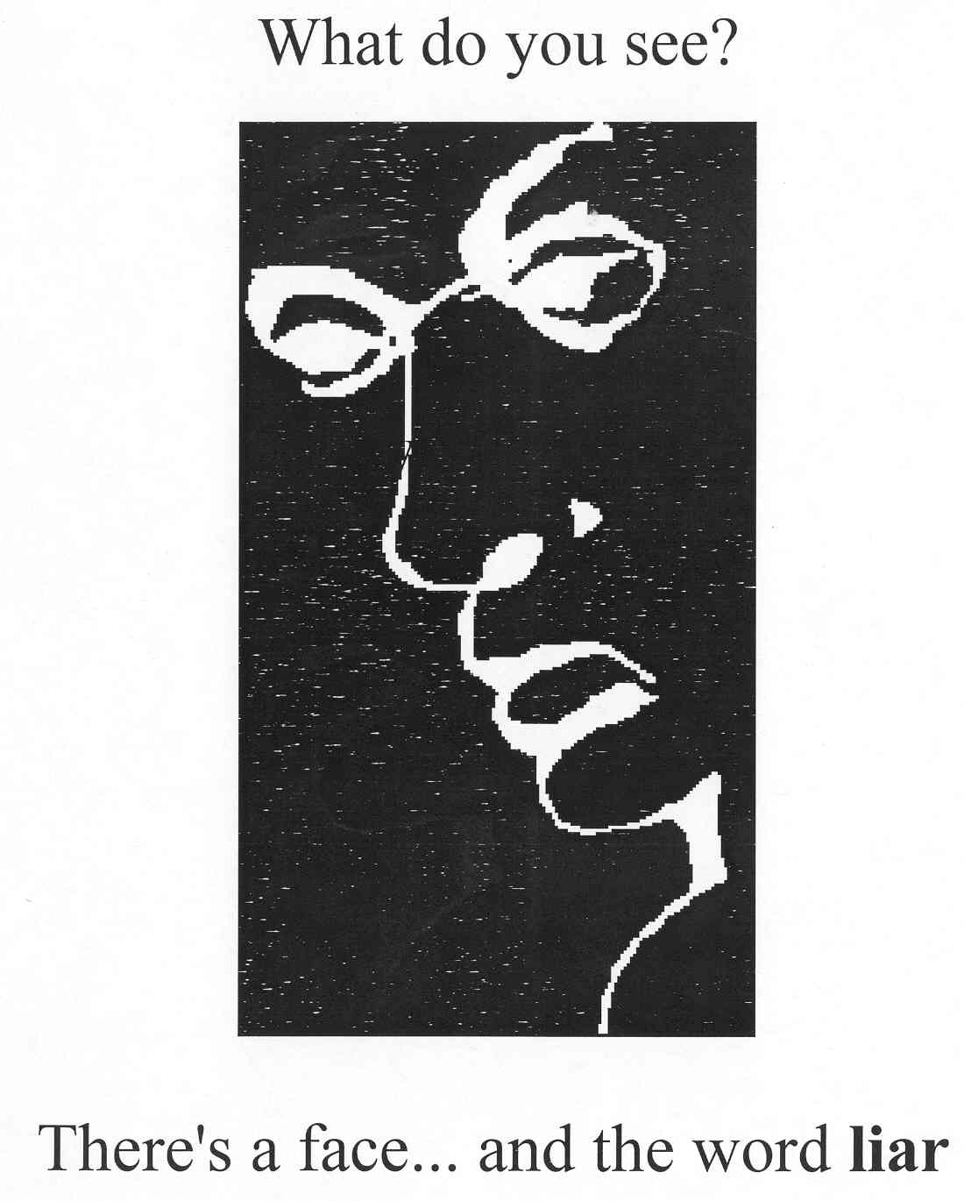
bboard65
Figure and Ground

Slide 4
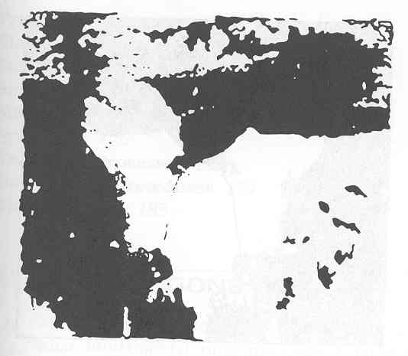
Slide 70—Schiffman Figure 7.24

Slide 5
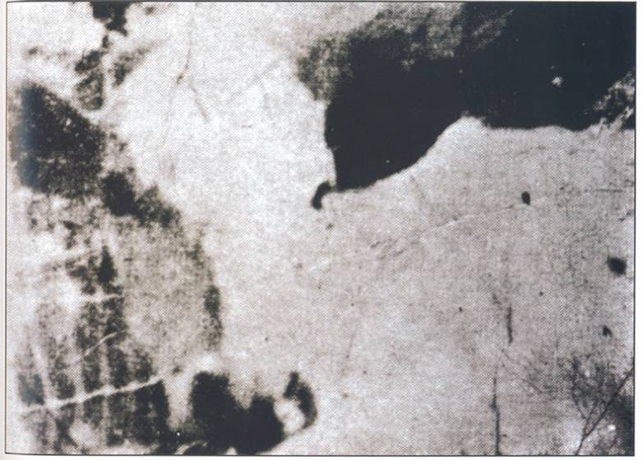
Slide 70-Seckel-Page 77

Slide 6
Bottom Up
Gestalts - grouping principles
  Proximity
  Good continuation
  Closure
  Similarity

Slide 7
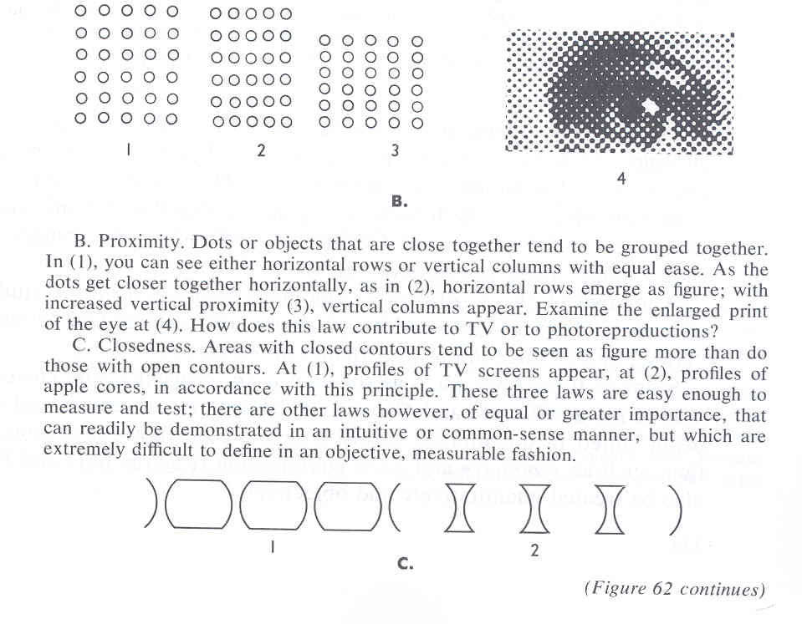
Slide 67-Hochberg Figure 62b and 62c
Proximity

Slide 8
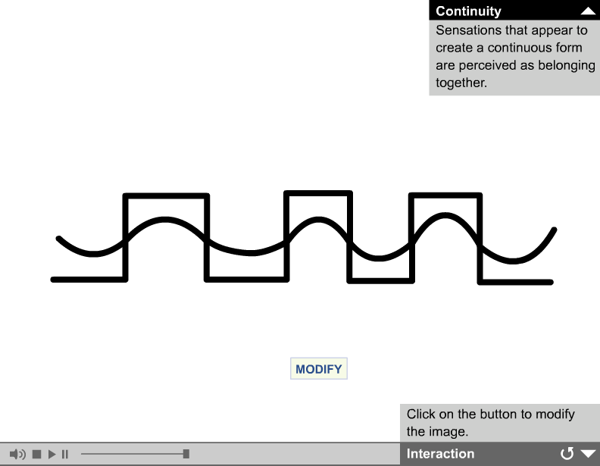

Slide 9
Good Continuation

Slide 10
Good Continuation

Slide 11
Closure

Slide 12
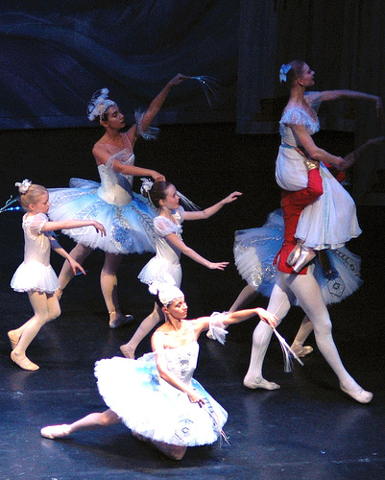
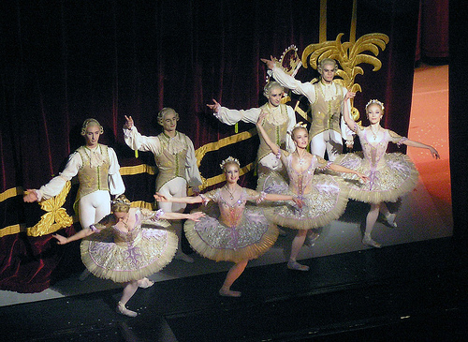
Similarity

Slide 13
Bottom Up
Depth Processing
  Visual Cliff Study
  Binocular Cues
  Monocular Cues

Slide 14
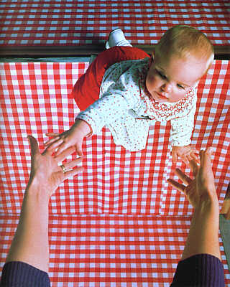
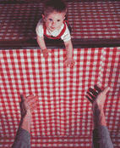

Slide 15
Bottom Up
Binocular Cues
  Retinal disparity
  Motion Parallax

Slide 16
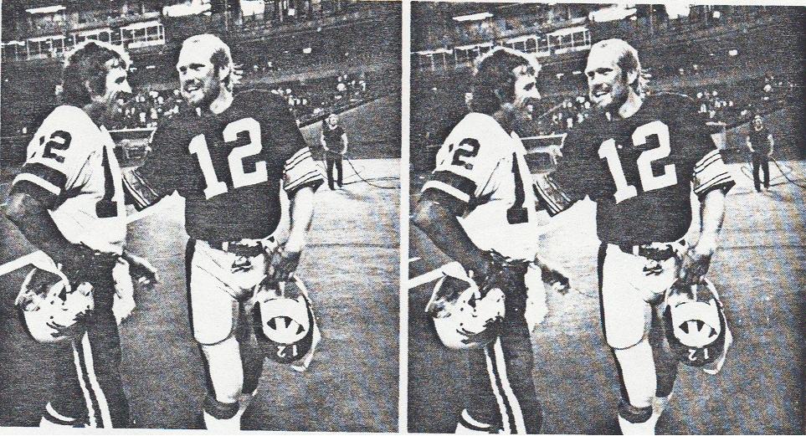

Slide 17
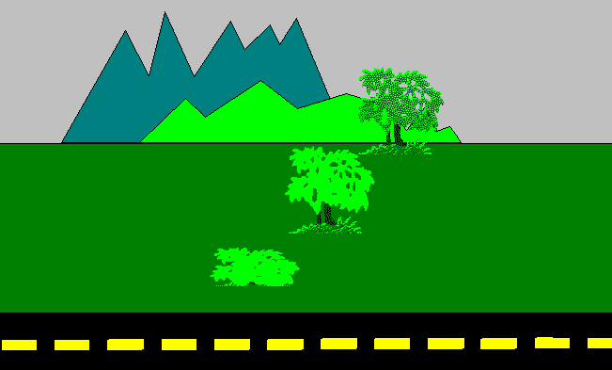

Slide 18
Bottom Up
Monocular Cues
  Linear Perspective
  Occlusion
  Texture Gradient
  Aerial Perspective
  Light and Dark

Slide 19
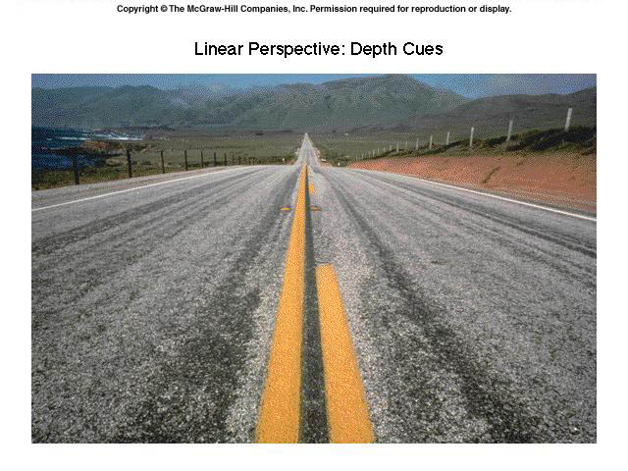

Slide 20
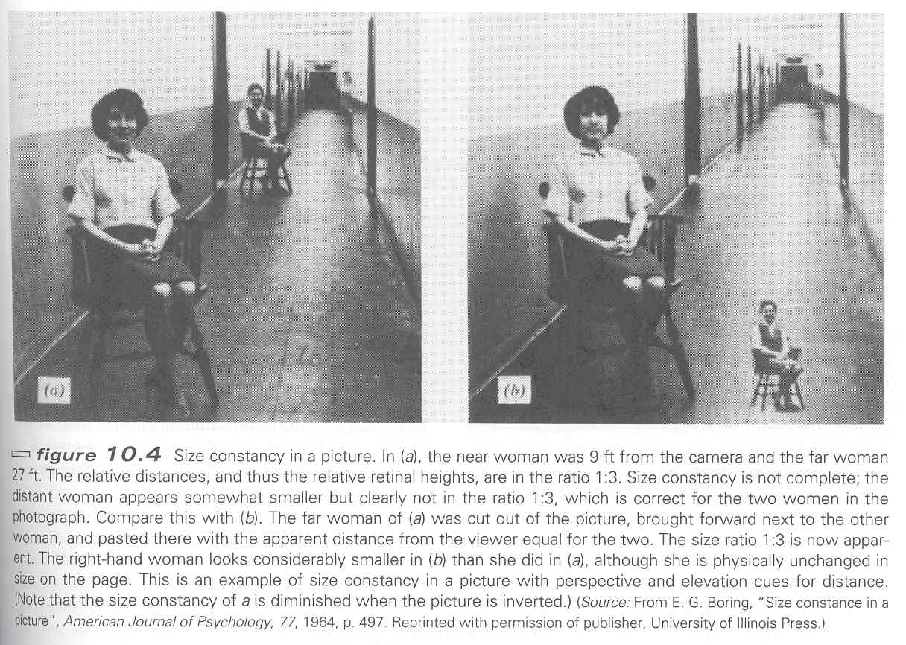
Slide 52-Schiffman Figure 10.4

Slide 21
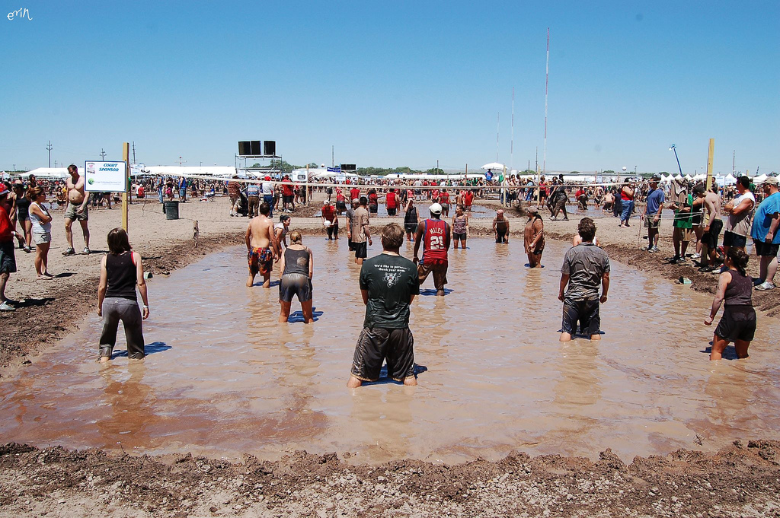

Slide 22
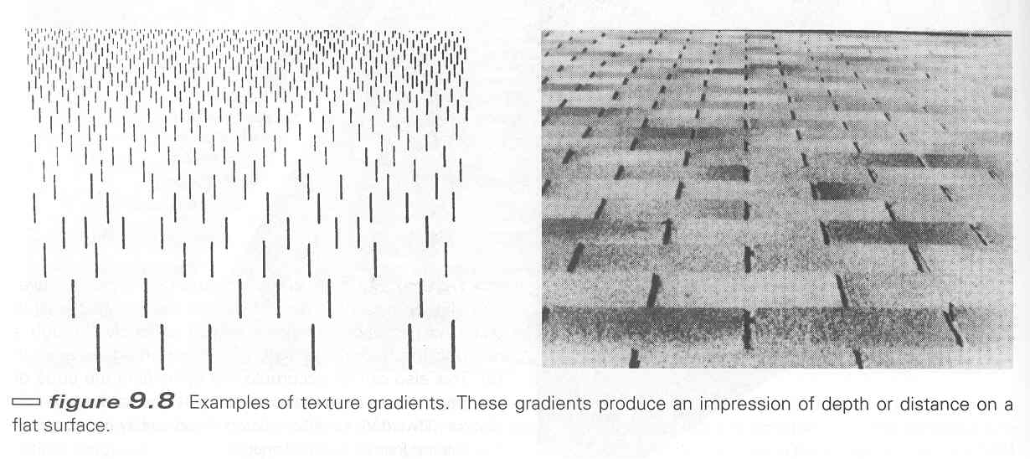
Slide 40-Schiffman Figure 9.8

Slide 23


Slide 24


Slide 25
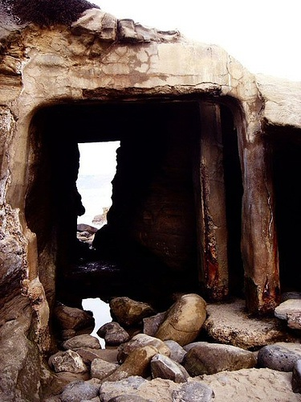

Slide 26
Question
We see: color, shape, motion, etc.
  How does it all get put together into a coherent message?
The binding problem

